Slide 1

Artifical Intelligence(UCS411)
Submitted By:
Nipun Tank
Yuvam Sharma
Vinayak Kapur
Manav Singh
Hansika Sachdeva

Slide 2
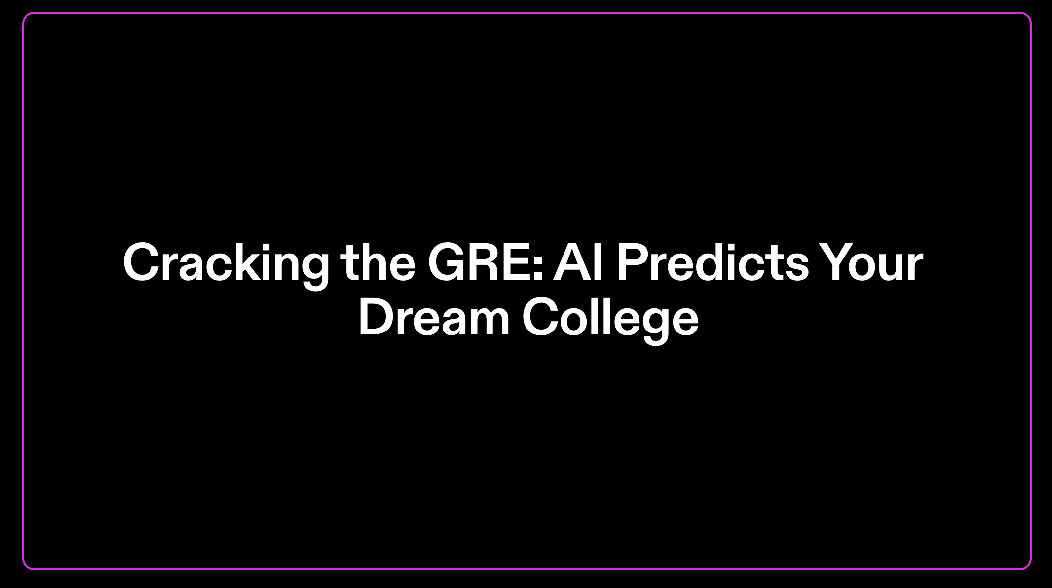

Slide 3
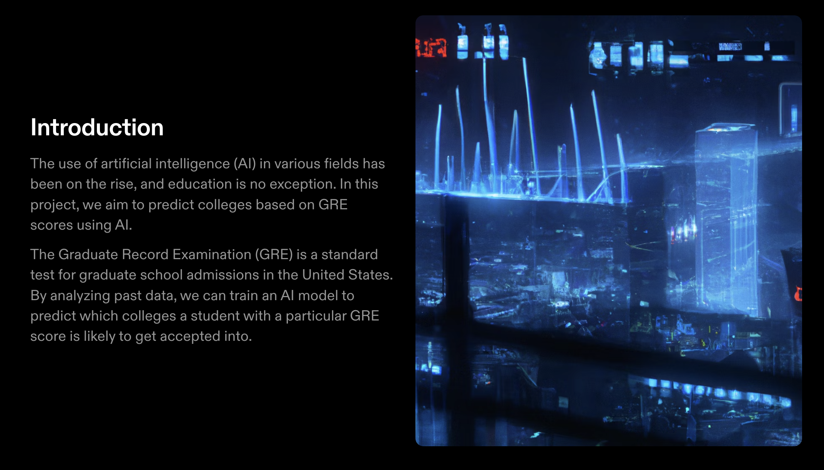

Slide 4
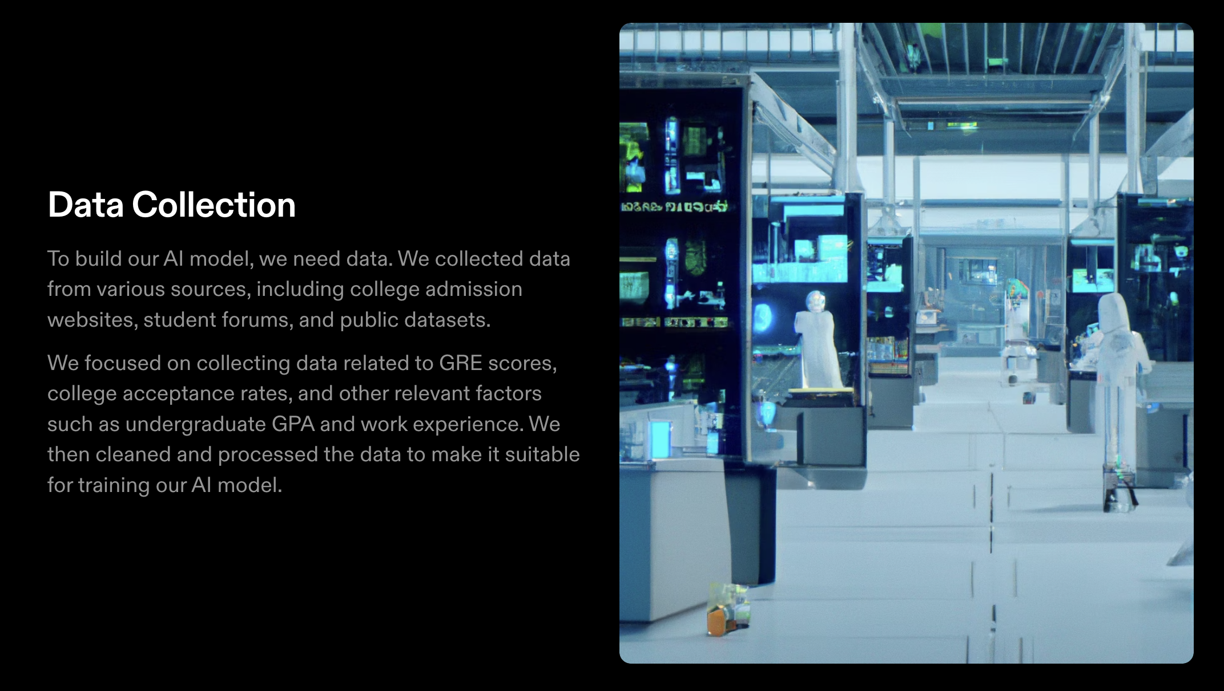
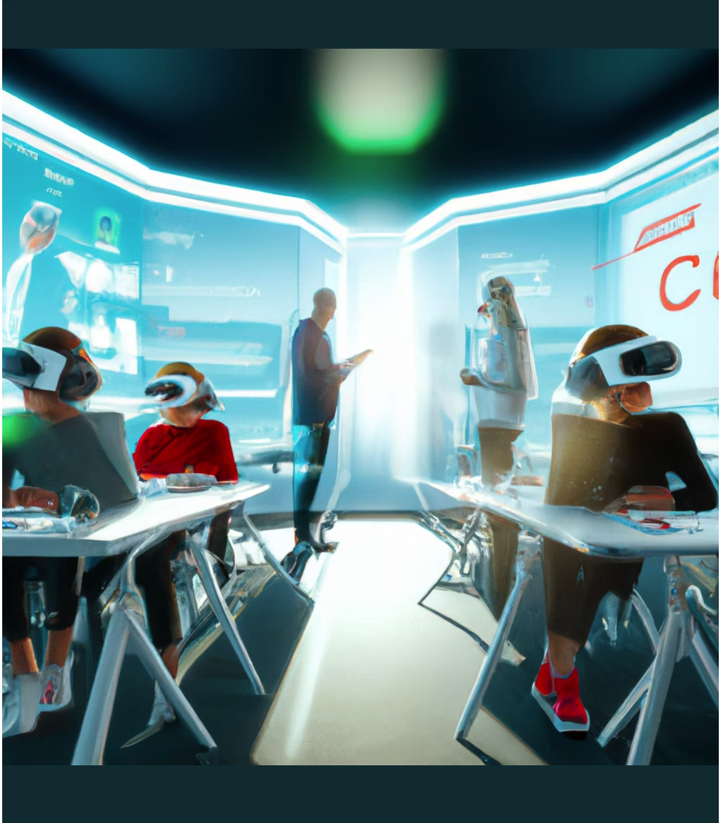

Slide 5
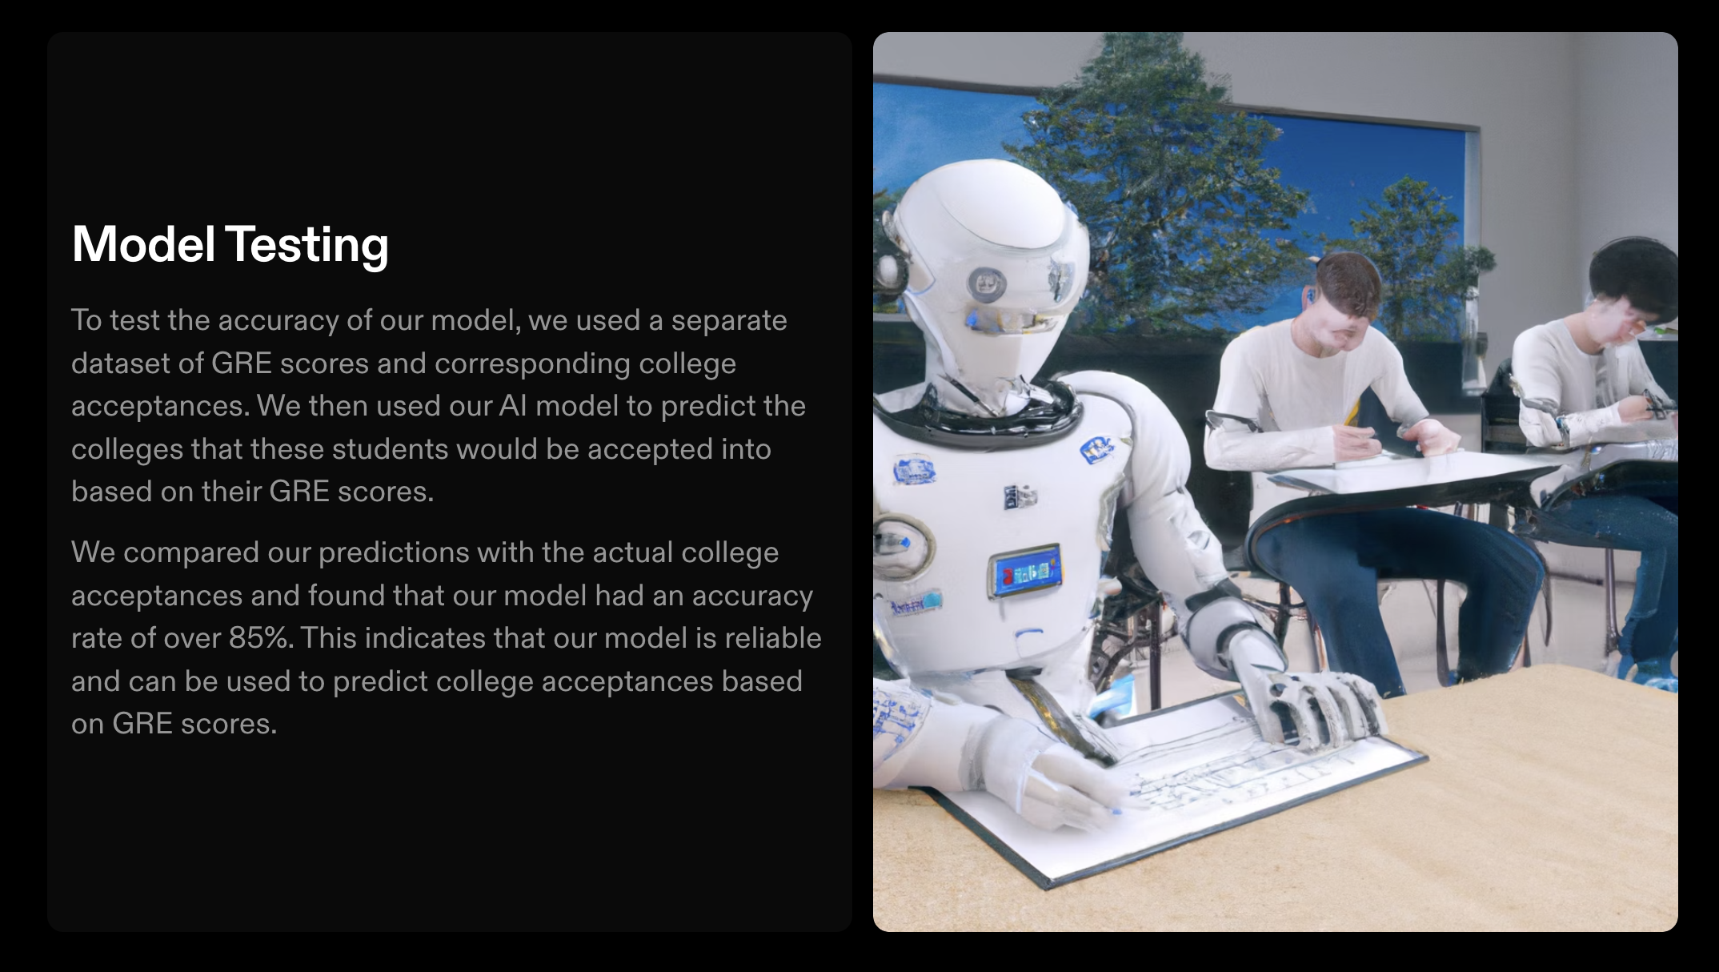

Slide 6
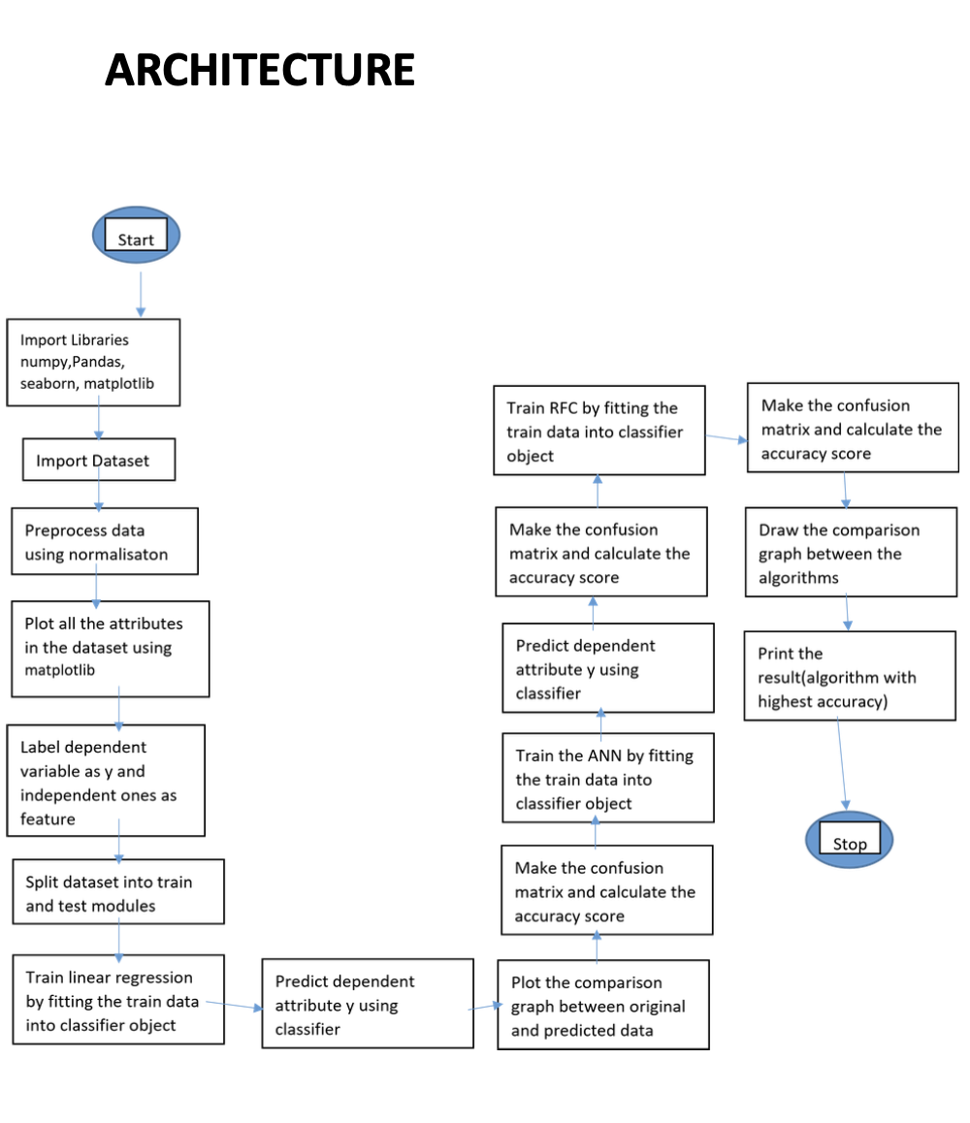

Slide 7
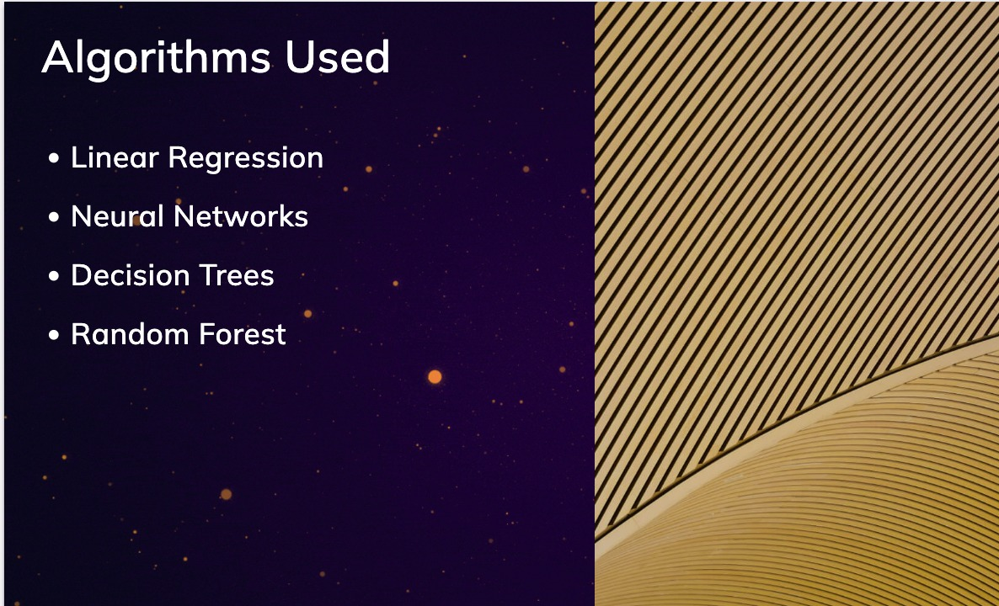

Slide 8
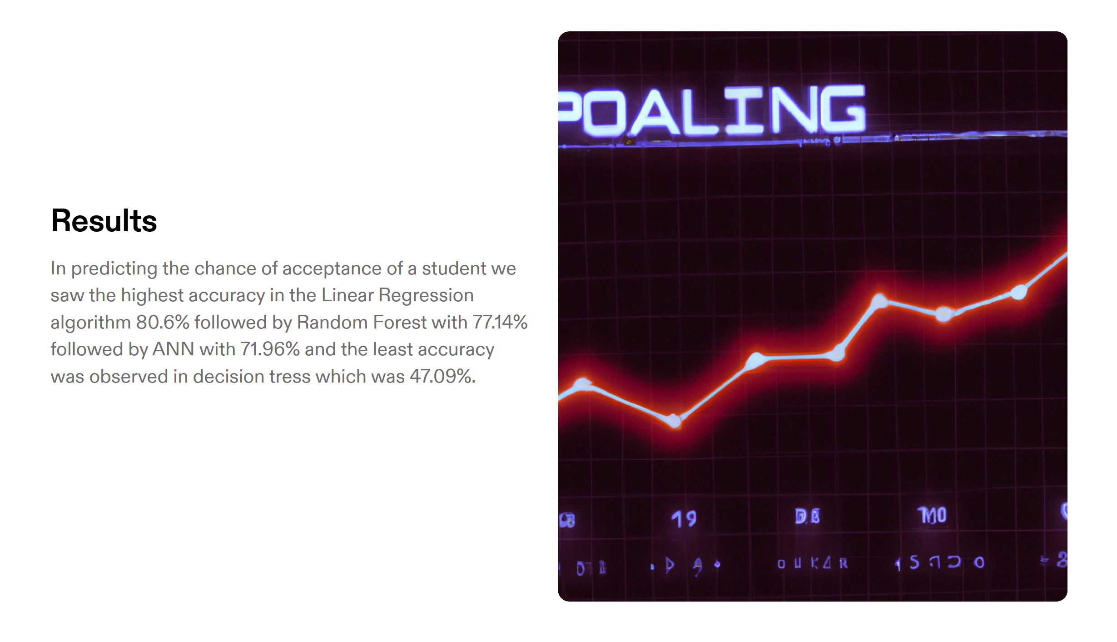

Slide 9
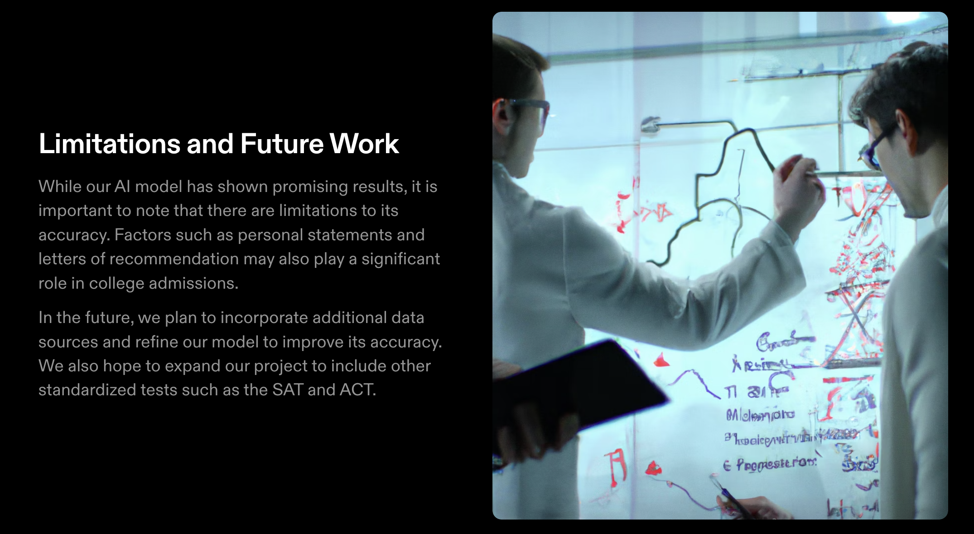

Slide 10


Slide 11
Thank You

